Slide 1

Internet Technologies
ITI & XI-IT
Lesson 6: Search Engine Optimization
Henrik Lange

Slide 2
Plan
Week 1: HTML & CSS
Week 2: JavaScript
Week 3: HTTP, PHP & AJAX (march 1st)
Week 4: MariaDB / MySQL (march 8th)
Week 5: Recap, Internet History, Project help (march 15th)
Week 6: Project Hand-In (march 22nd)
Week 6: OOP PHP, MVC, Routers, Reflection
Week 6: Midway Evaluation
Week 7: Project Presentation (march 29th)
Week 7: Assignment 2 specification
Week 8: API’s, REST & SOAP
Week 9: Libraries & Frameworks
(Bootstrap, jQuery, Leaflet, Google Charts)
Week 10: Search Engine Optimization
Week 11: JavaScript, .net
Week 11: Assignment 2 Hand-in
Week 12: Presentations, Feedback, Recap, Exam Questions, Exam Plan

Slide 3
Agenda
Assignment 2
Search Engine Optimization (SEO)
META
Minification
Sitemaps
Robots
SEO details
SEO Analysis

Slide 4
Assignment 2
Who is done with assignment 2?
Who is more than half way through it?
Who will be done on time (for sure?)

Slide 5
Assignment 2
I have received an alarming number of emails from people who find the task too big
I have amended the demands to only require the following
Use MVC (my template or something else)
Build an API
Requirements are in assignment on BlackBoard
Test application is available on GitHub
Test application should be run on a separate PHP instance
Let’s take a look
If the test works (and you are not circumventing it) – then your assignment will pass

Slide 6
Search Engine Optimization
A measurable, repeatable process that is used to send signals to search engines that your pages are worth showing in their indexes
Google (and others) use algorithms to give every website a score, which in turn decides how high the site will rank in search results
How do search engines find your site and all its subsites?

Slide 7
Web Crawlers
Search engines use web crawlers to find sites and subsites
A web crawler goes to a specific site and then visits all the links it can find
It then visits all the links it finds on those site
…and so on…
We can make life easier for these bots in two ways:
robots.txt
sitemap.xml

Slide 8
robots.txt
Your site should contain a robots.txt file
The basic format is a repetition of this:
Line breaks are part of the syntax here
User-agent is the name of the crawler
“Allow” is specific for googlebot
Can be used to allow subfolders of a disallowed folder
Crawl delay is set in seconds
Sitemap points to one or more sitemaps
* is a wildcard, $ means end of URL
User-agent: [user-agent name]
Allow: [URL to crawl]
Disallow: [URL string not to be crawled]
Sitemap: [sitemap.xml URL]

Slide 9
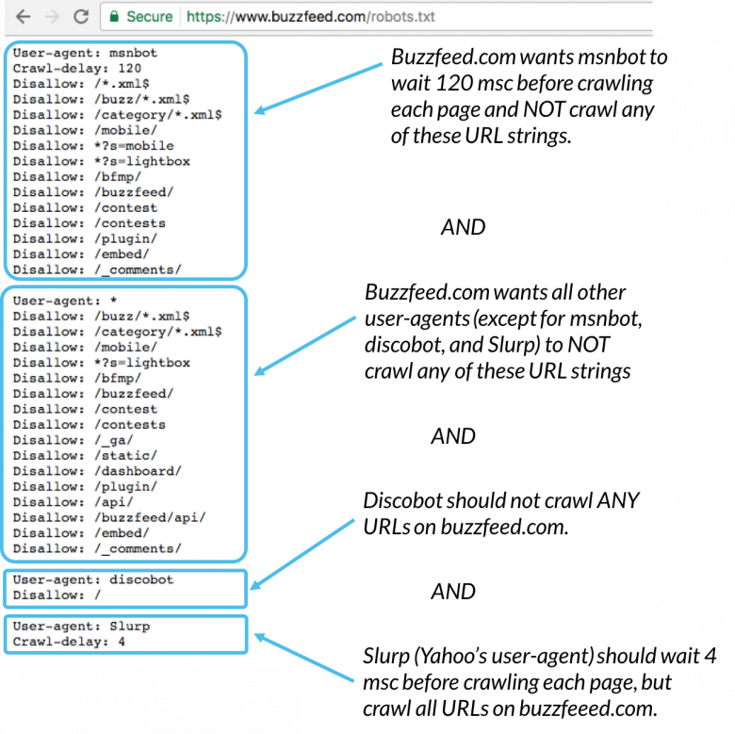
robots.txt
Example from buzzfeed.com
More:
https://moz.com/learn/seo/robotstxt

Slide 10
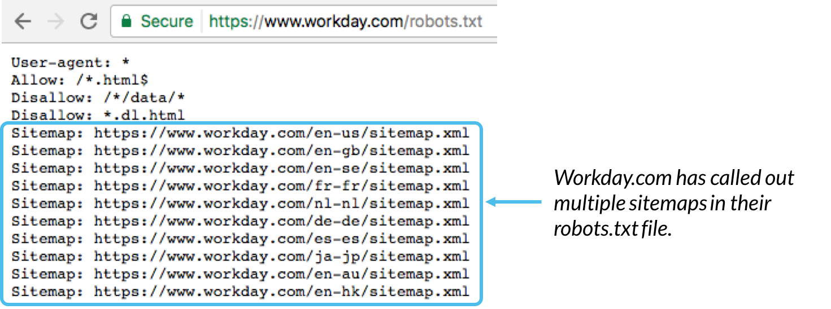
robots.txt
The file should be in the websites top-level directory
Filename is case-sensitive
Should be all lower case letters
The file is completely ignorable and sets no security
You can put one in each sub-domain
Sitemaps should be included in the bottom of the robots.txt file

Slide 11
sitemap.xml
A sitemap is a file that contains info about pages, videos and files and their relationships
Contains info about
Latest update to a page
Alternate language versions
A sitemap video entry can specify the video running time, category, and age appropriateness rating.
A sitemap image entry can include the image subject matter, type, and license.

Slide 12
sitemap.xml
A sitemap is a file that contains info about pages, videos and files and their relationships
Contains info about
Latest update to a page
Alternate language versions
A sitemap video entry can specify the video running time, category, and age appropriateness rating.
A sitemap image entry can include the image subject matter, type, and license
A sitemap can link to more sitemaps
A sitemap can be automatically generated
https://www.xml-sitemaps.com/

Slide 13
sitemap.xml
Example sitemap
<?xml version="1.0" encoding="UTF-8"?>
<urlset xmlns="http://www.sitemaps.org/schemas/sitemap/0.9">
<url>
<loc>http://www.example.com/</loc>
<lastmod>2005-01-01</lastmod>
<changefreq>monthly</changefreq>
<priority>0.8</priority>
</url>
<url>
<loc>http://www.example.com/something</loc>
<changefreq>weekly</changefreq>
<priority>0.3</priority>
</url>
</urlset>

Slide 14
sitemap.xml
Example sitemap index
<?xml version="1.0" encoding="UTF-8"?>
<sitemapindex xmlns="http://www.sitemaps.org/schemas/sitemap/0.9">
<sitemap>
<loc>http://www.example.com/sitemap1.xml</loc>
<lastmod>2004-10-01T18:23:17+00:00</lastmod>
</sitemap>
<sitemap>
<loc>http://www.example.com/sitemap2.xml</loc>
<lastmod>2005-01-01</lastmod>
</sitemap>
</sitemapindex>

Slide 15
sitemap.xml
Sitemap should be available from URL root
Should be mentioned in robots.txt
Sitemap.xml and robots.txt work fine independently

Slide 16
Search Engine Optimization
How does a search engine select which sites to show first?
Number of clicks?
Clickbait becomes a problem
Links to other sites?
Too easy to do
Links from other sites?
A good indication, but can be problematic
Spamming links everywhere shouldn’t be a valid strategy
Age of content?
Can be faked

Slide 17
Search Engine Optimization
Parameters for site value are often
Site quality
Site links (incoming, not outgoing)
Site trust

Slide 18
Site quality
Is HTML valid?
Is SSL enabled?
Is content unique
Duplicated content adds no value to end users

Slide 19
Site links
How many sites link to you?
Posting links to your own site in comment sections or on facebook or twitter will not do the trick
Get writers to actually mention your site in their articles and blogs
Words in links are important
Amazon might show up in searches for “book” if it is often linked as <a …>book</a>

Slide 20
Site trust
Sites can be reviewed on google
Consistent bad reviews lead to lower search index
User interaction
Popularity
Google analytics can help with that

Slide 21
META
HTML Meta element is in the start of the HTML Head
Defines keywords Search words
Defines how links are shown on other pages
Example 1 - Define keywords for search engines:
<meta name="keywords" content="HTML, CSS, XML, XHTML, JavaScript">
Example 2 - Define a description of your web page:
<meta name="description" content="Free Web tutorials on HTML and CSS">
Example 3 - Define the author of a page:
<meta name="author" content="John Doe">
Example 4 - Refresh document every 30 seconds:
<meta http-equiv="refresh" content="30">

Slide 22

META – For Facebook
<meta property="og:title" content="European Travel Destinations">
<meta property="og:description" content="Offering tour packages for individuals or groups.">
<meta property="og:image" content="http://euro-travel-example.com/thumbnail.jpg">
<meta property="og:url" content="http://euro-travel-example.com/index.htm">

Slide 23
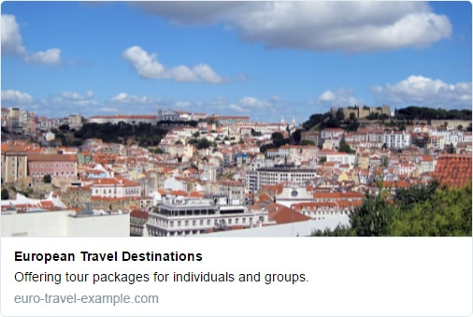
META – For Twitter
<meta name="twitter:title" content="European Travel Destinations ">
<meta name="twitter:description" content=" Offering tour packages for individuals or groups.">
<meta name="twitter:image" content=" http://euro-travel-example.com/thumbnail.jpg">
<meta name="twitter:card" content="summary_large_image">

Slide 24
META – For Google
<title>The Title of the Page</title>
<meta name="description" content="A description of the page" />
<meta name="robots" content=“noindex,nofollow,nosnippet,noimageindex" />
<meta name="googlebot" content="" />
<meta name="google" content="nositelinkssearchbox" />
<meta name="google" content="notranslate" />
<meta name="google-site-verification" content=“site-key" />

Slide 25
Minification
Remove all whitespace from css and js files to make them smaller and faster to load
Can be done with automatic tools:
https://www.minifier.org/
For us:
For the web:
div a.link{
color: black;
decoration: none;
}
div a.link{color:black;decoration:none}
let counter = 0;
function count() {
return ++counter;
}
let counter=0;function count(){return++counter}

Slide 26
Code quality
Generating code with PHP (or something else) makes the resulting code more error prone
Browsers are forgiving, but search engines are not
Check your sites HTML with a free tool
http://www.htmlhelp.com/tools/validator/
Let’s try it!

Slide 27
Content
Are pages well written with substantial quality content?
Which keywords are people using to search for you?
Use specific keywords rather than broad terms
Is this store in Denmark, Odense or Hjallese?
Are the keywords also used in the text and headers?
Are pages “fresh” with new and relevant content?
Use images and video to make site exciting
Is your content built as direct search result answers?
Is spelling and grammar okay
Is content available in multiple languages?

Slide 28
Architecture
Can search engines easily crawl the site?
robots and sitemap
Does your page work well on different screen sizes?
Does it fill a smartphone screen without overflowing to the side?
Is your site duplicating content of other sites?
How fast does the page load?
Minification and image sizes
Is the URL meaningful towards the content?
Is SSL used?
Is your site cloaked to look different for a bot than a real person?
Does all your media content have a meaningful ALT attribute?

Slide 29
HTML
TITLE should have overlap with keywords
META Description should be accurate and overlap with keywords and content (160 characters!)
Does the site use tables and lists where it should to enhance reading?
Make sure there is exactly one H1 element and that the site is structured with headers of relevant sizes
Are you stuffing the page with words you think people will search for?
Are you using styling to conceal content that is only in place to fool search engines?

Slide 30
Trust
Do links, shares and other factors make the page trusted?
Do visitors stay and interact or go away quickly?
Has the site existed in the same format for a long time?
Has site been flagged for hosting pirated content?
Is content ad-heavy?
Are ads intrusive?

Slide 31
Links
Are your links to trusted websites?
Do trusted websites link to you?
Do links to your site overlap with keywords?
Have you purchased links in hope of better ranking?
(You can’t on a trusted website)
Have you spammed links to the site in blog comments, on forums, on facebook, etc.?
Posting is great and a good way to get clicks
Spamming is something else

Slide 32
Personal
Is your site relevant to the language and location of the searcher
Has the searcher used your site before?

Slide 33
Social
Do respected entities on social media share your content?
Is your content shared by many on social media?
By many != a lot

Slide 34
SEO Reports
There is a lot to keep track of
Chances are you will miss something
Often
Free online tools can help you identify problems
It may be helpful to use more than one
https://sitechecker.pro/
https://www.seoptimer.com/
https://seositecheckup.com/

Slide 35
Next time
We will continue with:
Assignment 1 presentation
Assignment 2 specification

